Slide 1
EPR for packaging in Europe
Learnings and best practices
Joachim Quoden,
Managing Director of EXPRA

Slide 2
We are EXPRA
Established in 2013.
New coalition for packaging and packaging waste recovery and recycling systems (compliance schemes) which are owned by obliged industry.
Strong focus on inhabitants and municipal / household packaging.
Currently, 19 members in 16 European countries and in Israel and Quebec, Canada.
Working in close partnership with obliged companies and local authorities.

Slide 3
Our mission
To enable members to continuously improve their services by ensuring low costs to their client companies and convenient infrastructure for inhabitants
To promote a sustainable and efficient, not-for-profit/profit-not-for-distribution EPR scheme, driven by the obliged industry and offering a service of public or collective interest.
To provide a platform for exchange of experience and know how for our members but also for other stakeholders

Slide 4
Our Beliefs -1-
EPR organisations should be run by obliged companies on a not-for-profit basis
EPR organisations should control the use of the fees collected, and influence infrastructure design
In order to ensure that the right legislation is in place and implemented, different stakeholders have clear roles to play
Packaging optimisation, design-for-recycling, clear communication and education of inhabitants and company representatives are essential parts of successful EPR systems

Slide 5
Our Beliefs -2-
Transparency of operations is crucial
The fees for all materials covered should be calculated in a fair manner
Separate collection and waste infrastructure that covers out of home consumption should be further promoted
The aim should be to continuously improve system performance

Slide 6
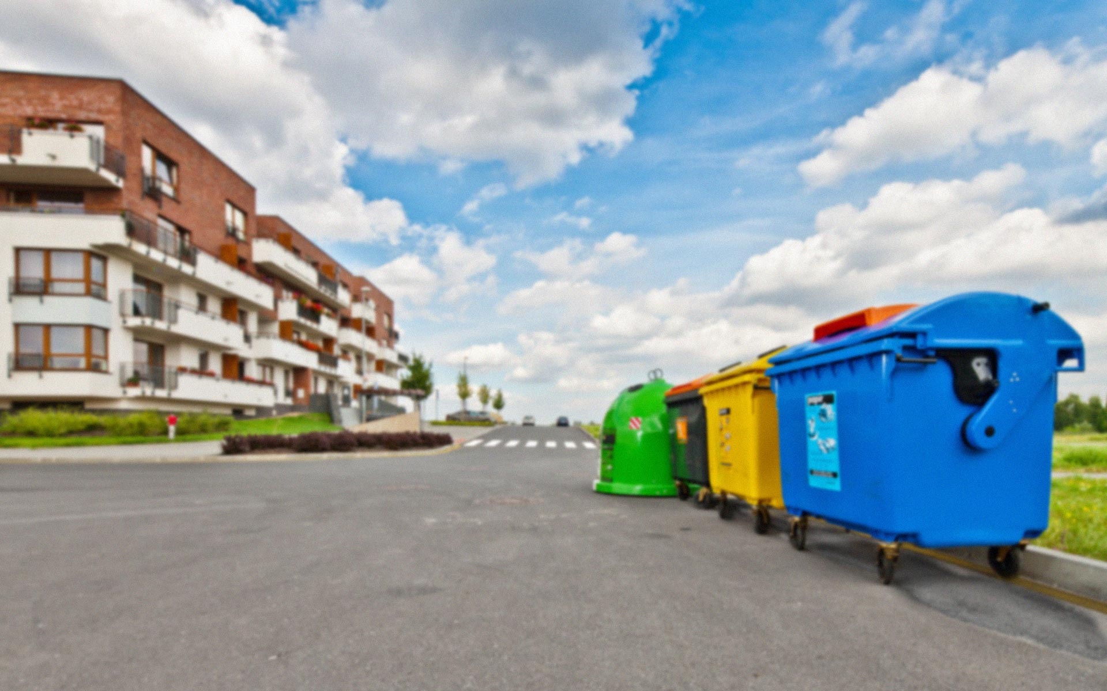
EU Member State Performance

Slide 7
European Packaging Directive 94/62/EG
Several special deadlines for new member states until 2015

Slide 8
Overall Recycling Quotas in 2011

Slide 9
Plastic Recycling Quotas in 2011
Deposit and taxes are no guarantee for high recycling performance: Denmark

Slide 10
EUROSTAT

Slide 11
Why these differences in performance?
What are best practices in the leading countries? What are the pitfalls in the followers?
Clear legislation, monitored in a strong way
Clear allocation of responsibilities for each stakeholder, e.g. take back obligation for the packaging value chain
Focus on municipal packaging waste
No conflict of interests within the involved players
Close and positive cooperation especially between municipalities and the EPR scheme

Slide 12
Implementation of the Packaging Directive
3 countries without any compliance scheme => Taxes
Denmark, Hungary, Croatia
Tax versus EPR
Ukraine ?
36 European countries
1 country with Tradedable certificates
UK
Collection costs are paid by municipalities
1 country with Fund Scheme run by industry
Iceland
30 with Producer Responsibility
Austria, Belgium, France, Spain, Germany, Ireland, Cyprus, Luxembourg, Portugal, Sweden, Greece, Latvia, Malta, Lithuania, Czech Republic, Slovak Republic, Italy, Slovenia, Estonia, Romania, Bulgaria, Turkey, Norway, Finland, Serbia, Israel, Netherlands, Poland, Macedonia, Bosnia

Slide 13
Producer responsibility- several ways of implementation
    „Dual model” (e.g. Austria, Germany)
    Full responsibility for industry for collection, sorting and recycling; separate collection system besides collection of local authorities, very small influence from local authorities
    „Shared model” (e.g. France, Spain, Czech Republic)
    Shared responsibility between industry and local authorities, common agreements on the way of collection necessary
    Tradable Credits Model (UK)
    No link between industry and collection at local level

Slide 14
Producer responsibility- several ways of implementation
    „EPR System in hands of obliged industry“ (Belgium, Spain, Italy, Netherlands, Norway, Czech, France, Ireland, Portugal, ….)
    Obliged industry has created 1 common non profit entity that collects the necessary funding, cooperates with local authorities and ensures recycling in most cost-efficient + environmental way
    „Vertical integrated systems“ (Germany, Poland, Romania, Bulgaria.. )
    Several usually profit oriented entities compete to attract obliged companies; waste management differs from country to country
    Tradable Credits Model with several traders (UK)
    No link between industry and collection at local level, no operational responsibility, virtual competition

Slide 15
Every country has its own competitive model
Germany:
  Collection infrastructure was built up in 15 years by a single service provider (DSD, 1990 – 2005) and by 10 years contract for collection and sorting with waste management companies
  So, competition on collection and sorting started only in 2003 / 2004 which led to a cost reduction of about 50%!
  Since 2005, several profit making entities (currently 10, but growing) use this collection infrastructure together
  Up to 2012, only DSD tendered collection; now tendering is done by all PRO‘s following a lottery system and a cost weight approach
  As 6 of the 10 PRO‘s are owned by waste management companies several anti trust problems because of vertical integration
  Clearing House owned by those entities collects market share information and publishes it
Notes:
Between 2003 and 2005 dropped plastics recycling rate by 26%
2013 60% of yellow bin is incenerated

Slide 16
Every country has its own competitive model
Germany:
  Obliged companies are not treated in the same way ; Every company pays a different fee to PRO‘s
  No transparent or public price lists
  So called A – clients pay much less than C – clients
  Services mainly offered to A – clients
  No transparency where the collected packaging is sorted, recycled or recovered
  Free rider rate minimum 33%
  No nationwide awareness raising towards the public anymore
  No prevention / eco – design initiatives for all obliged companies anymore

Slide 17
Every country has its own competitive model
Germany:
  Collection of 2.4 million t of lightweight packaging (2012)
  Reported and paid to PRO‘s 1.2 million t (2012); reported amounts are dropping in 2014 below 800.000t
  Recycled plastics 400.000t (2012)
  Local authorities call for complete change of system as they are not happy with the service level for their inhabitants!
  Ministry plans to give the Clearing House sovereign rights to increase enforcement + duty to call for tender
  Second Parliament Chamber will likely propose an „emergency-revision“ of the law to stop loopholes

Slide 18
Every country has its own competitive model
Poland:
  About 40 PRO‘s, thereof 1 owned by obliged industry (Rekopol)
  No special obligation to collect packaging from municipalities / households
  No common infrastructure for collection
  Most PRO‘s concentrate (especially for plastics) on commercial packaging
  Only Rekopol is investing in household collection, awareness raising with inhabitants and prevention
  So, only few local authorities have separate collection infrastructure

Slide 19
Every country has its own competitive model
Romania:
  About 6 PRO‘s, thereof 1 owned by obliged industry (Eco Rom)
  No special obligation to collect packaging from municipalities / households
  No common infrastructure for collection
  Most concentrate especially for plastics on commercial packaging
  Only Eco Rom is investing in household collection, awareness raising with inhabitants and prevention
  So, only few local authorities have separate collection infrastructure
Same counts for Bulgaria, Slovakia etc.

Slide 20
Every country has its own competitive model
Slovenia:
  About 5 PRO‘s, thereof 1 owned by obliged industry (SLOPAK); rest is vertically integrated
  No special obligation to collect packaging from municipalities
  Local authorities collect separately but most PRO‘s are refusing to pay and take the packaging waste
  Most concentrate especially for plastics on commercial packaging
  Only SLOPAK is taking the packaging waste from local authorities, awareness raising with inhabitants and prevention
  SLOPAK has difficulties to contract for sorting and recycling as these companies are owned by competitors

Slide 21

Fost Plus (Belgium)
How does the system work ?
Parties responsible for packaging (fillers)
Accreditation
IPC
(Interregional
Packaging Commission)
Verification
(Inter)municipalities
Waste management companies
Recyclers

Slide 22
Results Fost Plus (2012)
95% of the population sort their waste properly
111,6 kg/inhabitant collected
  66,7 kg paper-board (packaging and non-packaging)
  29,9 kg glass
  15,1 kg PMD (lightweight packaging)
81,9 % recycling (total HH market)
84,7 % recovery (total HH market)
Total cost of the system: 129,2 mio EUR
Revenue selling material: 61,5 mio EUR
Costs to be paid by obliged industry: 68 million € meaning 6 € per inhabitant!
Via recycling +recovery: reduction of 680.000 ton CO₂

Slide 23
Zdroj: EK
HH – household packaging waste
C&I - Commercial and industry packaging waste
ALL – All packaging waste
Notes:
Czechia and Neetherland collect all plastics which is not case in Belgium.

Slide 24
Zdroj: EK
HH – household packaging waste
C&I - Commercial and industry packaging waste
ALL – All packaging waste

Slide 25
Findings from the BIOIS EPR Guidelines study for the European Commission
“In case competition exists or arises among several PROs, actors should be enabled to compete fairly, within a clear and stable framework, thorough control and equal rules for all, realistic enforcement measures in case of irregularities and transparency.”
“When PROs expand beyond their role as facilitators and become operators of collection or treatment, ensure strict separation of these activities (especially through separate accounting).”
“Ensure equal treatment of all concerned producers, i.e. by requiring that producers have access to PRO membership if they so wish”

Slide 26
Findings from the BIOIS study for the European Commission
“In the case of competing PROs, an independent clearinghouse, is necessary. This structure should have the following objectives:
Centralisation and aggregation of data reported and control on data quality and completeness (“Register” role)
Control over compliance (free-riders identification), in link with public authorities in charge of enforcement
Ensuring that all competing PROs work in a level-playing field, by verifying that all requirements are met
Calculating market shares and ensuring a fair determination of the PRO’s individual objectives
When necessary, organizing the sharing of costs related to certain operations (e.g. reimbursement of local authorities, national communication campaigns), through common agreements with public local authorities, or through common call for tenders.
This structure may also manage common communication and R&D activities.”

Slide 27
Conclusions?
So, is competition at the system level the right way to achieve your goals?
Competition at the operational level covers 85% – 90% of all costs and ensures an optimized system
Competition at system level adds a lot of complexity, asks much more enforcement and control from government, and still needs a common body called clearinghouse with many of the single service provider tasks!

Slide 28
So, how should the ideal system look like?
The system should be in the hands of obliged industry, run on a non-profit basis
The system and local authorities should organize the collection in close cooperation
All operational matters should be organized on a call for tender basis
Vertical integration with waste management companies should be avoided
The system and its way of acting should be as transparent and public as possible
Prevention / eco design is an integral part of the system in close cooperation with obliged industry

Slide 29
The EU waste policy review 2014 / 2016
The Fitness Check of EU waste policy
In the PPWD revision:
Introduce a specific reference to EPR in the PPWD directive
Keep specific requirements in the PPWD
The waste target review
PPWD targets should not be incorporated within the WFD targets
EXPRA would be in favour of assessing higher targets for different waste streams, if the necessary conditions such as harmonised and consistent definitions, data collection techniques and calculation methods are in place first

Slide 30
EPR Guidelines
Commission developing guidelines on EPR
  Follows 2012 study on the use of Economic Instruments and Waste Management Performances, according to which:
  EPR is an effective tool to shift waste streams to more sustainable paths
EXPRA would welcome EPR guidelines to promote best practices and transparency, efficiency and performance
The not-for-profit / profit not for distribution approach to EPR should be further promoted at EU level and each player needs to have a clearly defined role

Slide 31
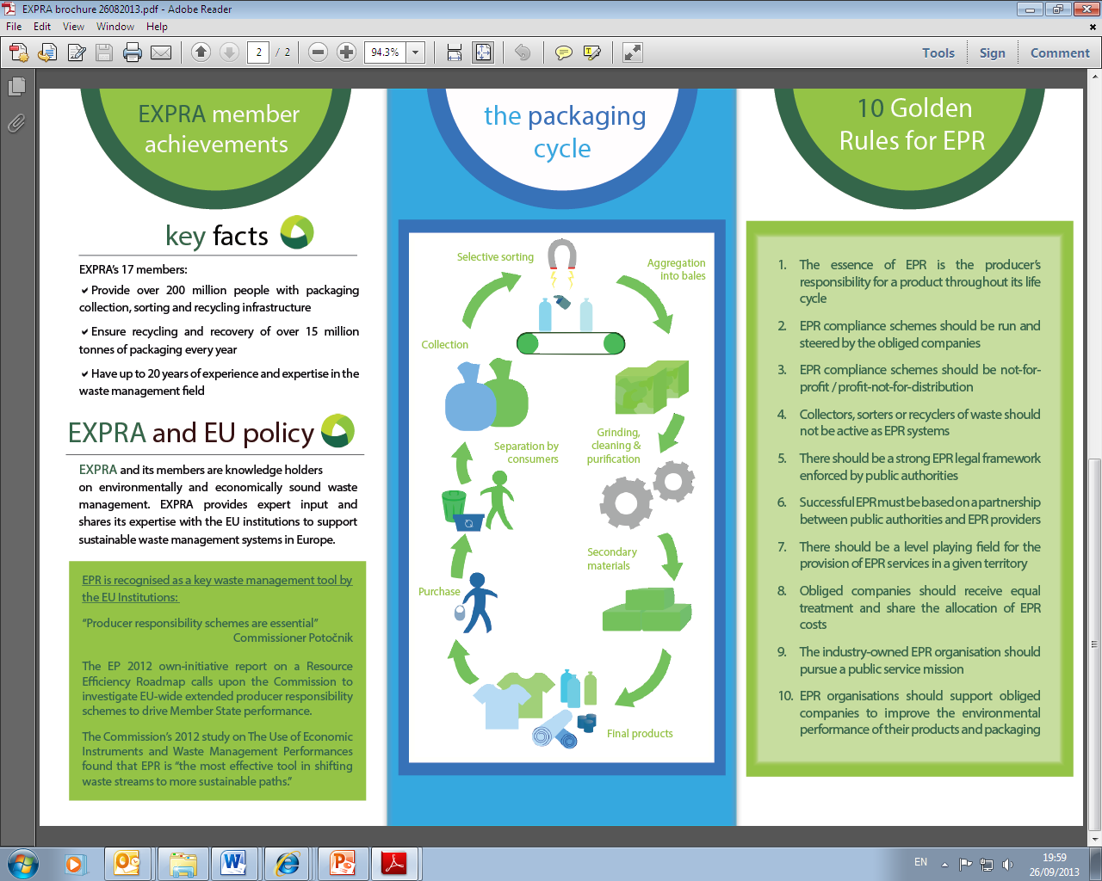
How can we help?
Joachim Quoden
Managing Director
EXPRA aisbl
2 Avenue des Olympiades
1140 Brussels – Evere
Belgium
joachim.quoden@expra.eu

Slide 32
EXPRA
Extended Producer Responsibility Alliance
INSPIRING PACKAGING RECYCLING
www.expra.eu

Slide 33
PARTNERSHIP IS A KEY TO SUCCESS

